Slide 1




TEXAS FAMILY CODE
INSTRUCTOR: OFFICER COLE LANGSTON
CARROLLTON POLICE DEPARTMENT

Slide 2
History Lesson
Juveniles had no rights. Were property
15th Century: Poor Laws. Police rounded up street kids and gave them to people to work as servants until they were 21
Settlers of U.S. used Common Law. Dad had absolute power over child. Clergy and schools also could do anything to a child, including beat them
1800’s founded first Juvenile Courts. Not created to protect child. First time decided to separate kids from adult prisoners
1954 was first court opinion addressing juvenile rights: In Re Holmes said state can intervene on part of a juvenile giving state authority to remove child from home and place elsewhere. No criminal rights. Civil action only.
1973 Title III of the Family Code was written
1996 Title III was re-written
1997 Title III re-write went into effect and called the Juvenile Justice Code

Slide 3
What is a Juvenile/Minor?
  Penal Code 10-16
  TABC 0-20
  CCP (missing child) 0-17
  Family Code Title II & V 0-17
  Family Code Title III (Juv Justice) 10-16
  Traffic Code 0-16

Slide 4
IMPORTANT AGE LIMITS
AGE 10: Minimum age for Juvenile Court jurisdiction
AGE 14: Minimum age for certification for a Capital Felony, an Aggravated Controlled Substance Felony or any First Degree Felony
AGE 15: Minimum age for Certification for Second and Third Degree and
State Jail Felony offenses
AGE 16: Maximum age for committing juvenile offenses. Minimum age for transfer to adult prison for juvenile sentenced under Determinate Sentencing.
AGE 17: Minimum age for adult criminal jurisdiction. Offenses committed
after reaching age 17 handled as adult. Juvenile Court can have
jurisdiction over an adult for certain felony offenses committed
before his 17th birthday.
AGE 19: Maximum age a child can be in custody of TYC.

Slide 5
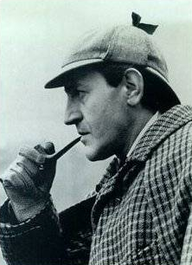
The Mysteries of Juvenile Law Revealed

Slide 6
Family Code
TITLE 1. THE MARRIAGE RELATIONSHIP
TITLE 2. CHILD IN RELATION TO THE FAMILY
TITLE 3. JUVENILE JUSTICE CODE
TITLE 4. PROTECTIVE ORDERS AND FAMILY VIOLENCE
TITLE 5. THE PARENT-CHILD RELATIONSHIP AND THE SUIT
        AFFECTING THE PARENT-CHILD RELATIONSHIP

Slide 7
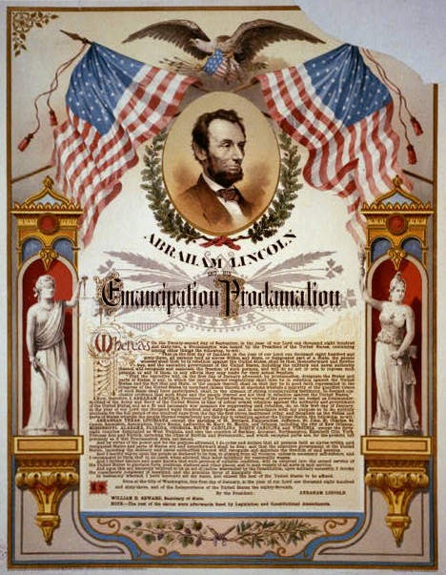
Emancipation
  Allows a minor to petition for emancipation if the minor is:
A resident of this state;
17 years of age, or at least 16 years of age and living separate and apart from the minor's parents, managing conservator, or guardian; and
Self-supporting and managing the
minor's own financial affairs.
The court shall appoint an amicus
attorney or attorney ad litem to
represent the interest of the
petitioner at the hearing.

Slide 8
Protective Custody
Family Code 262.110
Child: Under 18 and has not been married or who has not had the disabilities of minority removed
An officer may take temporary possession of a child without a court order on discovery of a child in a situation of danger to the child's physical health or safety when the sole purpose is to deliver the child without unnecessary delay to the parent, managing conservator, possessory conservator, guardian, caretaker, or custodian who is presently entitled to possession of the child
If a parent, guardian, or other person entitled to possession of the child is unavailable, the Department of Protective and Regulatory Services will take possession of the child

Slide 9
Protective Custody Without Intent to Return Child
Family Code 262104
Child: Under 18 and has not been married or who has not had the disabilities of minority removed
If there is no time to obtain a temporary restraining order or attachment before taking possession of a child consistent with the health and safety of that child, an authorized representative of the Department of Family and Protective Services, a law enforcement officer, or a juvenile probation officer may take possession of a child without a court order under the following conditions, only:

Slide 10
On personal knowledge of facts that would lead a person of ordinary prudence and caution to believe that there is an immediate danger to the physical health or safety of the child
On information furnished by another that has been corroborated by personal knowledge of facts and all of which taken together would lead a person of ordinary prudence and caution to believe that there is an immediate danger to the physical health or safety of the child
On personal knowledge of facts that would lead a person of ordinary prudence and caution to believe that the child has been the victim of sexual abuse
On information furnished by another that has been corroborated by personal knowledge of facts and all of which taken together would lead a person of ordinary prudence and caution to believe that the child has been the victim of sexual abuse
On information furnished by another that has been corroborated by personal knowledge of facts and all of which taken together would lead a person of ordinary prudence and caution to believe that the parent or person who has possession of the child is currently using a controlled substance as defined by Chapter 481, Health and Safety Code, and the use constitutes an immediate danger to the physical health or safety of the child
On personal knowledge or information furnished by another, that has been corroborated by personal knowledge, that would lead a person of ordinary prudence and caution to believe that the parent or person who has possession of the child has permitted the child to remain on premises used for the manufacture of methamphetamine.

Slide 11
The child may be released to the Department of Family and Protective Services or any other person authorized by law to take possession of the child
Written notice must be provided to each parent of the child or to the child’s conservator or legal guardian
The written notice must be given as soon as practicable, but in any event not later than the first working day after the date the child is taken into possession
The written notice must include:
  The reasons why the department or agency is taking possession of the child and the facts that led the department to believe that the child should be taken into custody;
  The name of the person at the department or agency that the parent, conservator, or other custodian may contact for information relating to the child or a legal proceeding relating to the child;
  A summary of legal rights of a parent, conservator, guardian, or other custodian under this chapter and an explanation of the probable legal procedures relating to the child; and
  A statement that the parent, conservator, or other custodian has the right to hire an attorney

Slide 12
Possession and Delivery of
Missing Child
Family Code Sec. 262.007
A law enforcement officer who, during a criminal investigation relating to a child's custody, discovers that a child is a missing child and believes that a person may flee with or conceal the child shall take possession of the child
An officer who takes possession of a child shall deliver or arrange for the delivery of the child to a person entitled to possession of the child
If a person entitled to possession of the child is not immediately available to take possession of the child, the law enforcement officer shall deliver the child to the Department of Protective and Regulatory Services

Slide 13
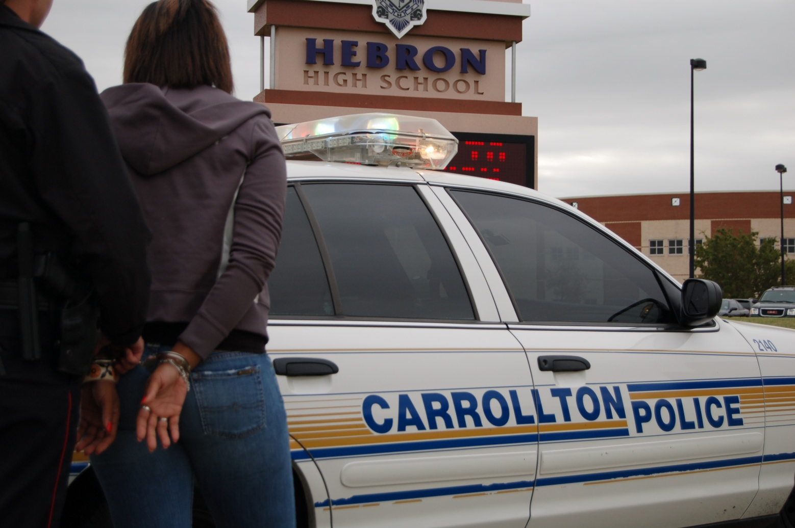
Arresting Juveniles

Slide 14
Age Affecting Criminal Responsibility
Penal Code 8.07
  A person may not be prosecuted for or convicted of any
  offense that the person committed while younger than 15
  years of age except:
    Perjury and Aggravated Perjury
    A violation of a penal statute cognizable under Chapter 729, Transportation Code (Operation of a Motor Vehicle by Minor in Violation of Traffic Laws and Operation of Motor Vehicle by Minor Without License), except for conduct for which the person convicted may be sentenced to imprisonment or confinement in jail
    A violation of a motor vehicle traffic ordinance of any incorporated city or town in this state

Slide 15
    A misdemeanor punishable by fine only other than public intoxication
    A violation of a penal ordinance of any political subdivision
    A violation of penal statute that is, or is a lesser included offense of, a capital felony, an aggravated controlled substance felony, or a felony of the first degree for which the person is transferred to the court under Section 54.02 Family Code, for prosecution if the person committed the offense when 14 years of age or older
    A capital felony or an offense under section 19.02 for which the person is transferred to the court under Section 54.02(j)(2)(A) Family Code.

Slide 16
What is a Child?
Family Code 51.02
  Defines a child as a person who is:
    Ten years of age or older and under 17
    Seventeen years of age or older and under 18 years of age who is alleged or found to have engaged in delinquent conduct or conduct indicating a need for supervision as a result of acts committed before becoming 17 years of age

Slide 17
Child in Need of Supervision
Family Code 51.03
Conduct, other than a Class C traffic offense, that violates: (A) the penal laws of this state of the grade of misdemeanor that are punishable by fine only; or (B) the penal ordinances of any political subdivision of this state
The absence of a child on 10 or more days or parts of days within a six-month period in the same school year or on three or more days or parts of days within a four-week period from school
The voluntary absence of a child from the child's home without the consent of the child's parent or guardian for a substantial length of time or without intent to return

Slide 18
Conduct prohibited by city ordinance or by state law involving the inhalation of the fumes or vapors of paint and other protective coatings or glue and other adhesives and the volatile chemicals itemized in Section 484.002, Health and Safety Code
An act that violates a school district's previously communicated written standards of student conduct for which the child has been expelled under Section 37.007(c), Education Code
Conduct that violates a reasonable and lawful order of a court entered under Section 264.305 (regarding CPS action against an At Risk Child)

Slide 19
Delinquent Conduct
Family Code 51.03
Conduct that violates a penal law of this state or of the United States punishable by imprisonment or by confinement in jail
Conduct that violates a lawful order of a court under circumstances that would constitute contempt of that court in: (A) a justice or municipal court; or (B) a county court for conduct punishable only by a fine
Conduct that violates Section 49.04, 49.05, 49.06, 49.07, or 49.08 (DWI statutes)
Conduct that violates Section 106.041, Alcoholic Beverage Code, relating to Driving Under the Influence of Alcohol by a Minor (third or subsequent offense)

Slide 20
Taking Into Custody
Family Code 52.01
  A child may be taken into custody:
  Pursuant to a Juvenile Court Order
  Pursuant to laws of arrest
  By a law enforcement officer if there is probable cause to believe the juvenile has engaged in conduct that violates a penal law of this state or a penal ordinance of any political subdivision of this state
  By a law enforcement officer if there is probable cause to believe the juvenile has engaged in Delinquent Conduct or Conduct Indicating a Need for Supervision or a Juvenile Court Probation Violation (this does not include deferred probation)

Slide 21
  By a probation officer if there is probable cause to believe that the child has violated a condition of Juvenile Court ordered probation
  Pursuant to a Directive to Apprehend (warrant)
  By a probation officer if there is probable cause to believe that the child has violated a condition of release imposed by the juvenile court
  By a law enforcement officer if there is probable cause to believe the child is violating compulsory attendance for the purpose of returning the child to school
  The taking of a child into custody is not an arrest except for the purpose of determining the validity of taking him into custody or the validity of a search under the laws and constitution of this state or of the United States.

Slide 22
What do I do with this child now?
Family Code 52.02
  The child shall be taken without unnecessary delay and
  without first taking the child to any place other than a
  Juvenile Processing Office you shall do one of the
  following:
  Release the child to a parent, guardian, custodian, or other responsible adult
  Bring the child before the office or official designated by the juvenile board if there is probable cause to believe that the child engaged in delinquent conduct, conduct indicating a need for supervision, or conduct that violates a condition of probation imposed by the juvenile court
  Bring the child to a detention facility designated by the juvenile board

Slide 23
  Bring the child to a secure detention facility
  Bring the child to a medical facility if the child is believed to suffer from a serious physical condition or illness that requires prompt treatment
  Dispose of the case without referral to court per Family Code 52.03
  Release the child to school
  A person taking a child into custody shall promptly give notice of the person's action and a statement of the reason for taking the child into custody, to the child’s parent, guardian, or custodian, and the office or official designated by the juvenile court
  A child may be taken to an adult facility to utilize an Intoxilyzer machine if the child has a detectable amount of alcohol in their system.

Slide 24

Notifying the Parents
Do it as SOON as you arrive at the JPO
YOU do it! Do not delegate it!
Provide the charge and a short statement of facts to the parent
Document all contacts or attempts at contact including times!

Slide 25

Bad Cop, No Donut
Violations of these rules may result in confessions and evidence being suppressed
Most common problems:
  Failure to go directly to JPO without necessary delay
  Failure to promptly notify parents
Roquemore v. State: Failure to bring juvenile directly to JPO resulted in suppression of stolen property from evidence
Suspect must establish a causal connection between the violation of the rule and the evidence being obtained or statement being given
The state must then disprove the violation or causal link or the evidence will be suppressed

Slide 26
Places and Conditions of Detention
Family Code 51.12
  A child may be detained only in a:
      Juvenile Processing Office
      Place of Non-Secure Custody
      (defined by CCP 45.058)
      Certified Juvenile Detention Facility
      Secure Detention Facility
  If the building also houses a jail or adult lockup, the child must be sight and sound separated from adults
  Children transferred to adult court may be held in an adult facility
  Persons at least 17 years of age and taken into custody for escape from TYC or TYC parole violation may be held in an adult facility.

Slide 27
Juvenile Processing Office
Family Code 52.025
  A room or office in a police facility used for the purpose of temporary detention of a child taken into custody
  Designated by Juvenile Board of the county
  May only be detained in a JPO for:
    Release of the child per Family Code 52.02
    Completion of essential forms
    Photographing and fingerprinting
    Issuance of warning notice
    Receipt of a statement from a child
  A child may not be left unattended in a JPO
  Child has a right while in JPO to have a parent or attorney present. Make reasonable efforts to locate a parent or attorney if requested.
  A child may not be detained in a juvenile processing office for longer than six hours (absolute rule)

Slide 28
Place of Non-Secure Custody
CCP 45.058
Unlocked, multipurpose area designated by the head of the agency
A lobby, office, or interrogation room is suitable if the area is not designated, set aside, or used as a secure detention area and is not part of a secure detention area
May be a juvenile processing office designated under Section 52.025, Family Code, if the area is not locked when it is used as a place of non-secure custody
Child may not be secured physically to a cuffing rail, chair, desk, or other stationary object

Slide 29
Place of Non-Secure Custody
CCP 45.058
Child may be held in the non-secure facility only long enough to accomplish the purpose of identification, investigation, processing, release to parents, or the arranging of transportation to the appropriate juvenile court, juvenile detention facility, secure detention facility, justice court, or municipal court
Residential use of the area is prohibited
The child shall be under continuous visual supervision by a law enforcement officer or facility staff person during the time the child is in non-secure custody
A child may not, under any circumstances, be detained in a place of non-secure custody for more than six hours
Note that there is no statutory requirement to allow a juvenile to be accompanied by a parent or attorney

Slide 30
Warning Notice
Family Code 52.01
A law-enforcement officer authorized to take a child into custody based on a probable cause arrest may issue a warning notice to the child in lieu of taking the child into custody:
  The agency must have guidelines for the use of warning notices
  Guidelines must be authorized by the county
  A copy must be sent to the child’s parent
  A copy must be filed with the county juvenile board

Slide 31
Right of Access to a Child
Family Code 61.103
  Parent’s right
  Right to communicate in person privately with the child in custody for reasonable periods of time
  The time, place, and conditions of the private, in-person communication may be regulated to prevent disruption of scheduled activities and to maintain the safety and security of the facility

Slide 32
Photographs and Fingerprints
Family Code 58.002
May photograph and fingerprint when taken into custody for Class B or greater offense or with written parental consent
Family Code 58.0021
May take temporary custody of a child to obtain prints or a photograph of the child if it will be of material assistance in an investigation if there is probable cause to believe the child engaged in delinquent conduct
Must notify parent of action taken
Must destroy prints and photos that do not lead to a positive identification
Prints and photos shall be obtained at a juvenile processing office or a location that affords reasonable privacy to the child

Slide 33
Physical Records or Files
Family Code 58.007
    New law that allows juveniles and their parents to obtain copies of reports
    Must redact many things such as witnesses and juvenile suspects

Slide 34
Offenses Involving Guns
Family Code 53.02 (f)
A child who is alleged to have engaged in delinquent conduct and to have used, possessed, or exhibited a firearm, as defined by Section 46.01, Penal Code, in the commission of the offense shall be detained until the child is released at the direction of the judge of the juvenile court, a substitute judge authorized by Section 51.04(f), or a referee appointed under Section 51.04(g), including an oral direction by telephone, or until a detention hearing is held as required by Section 54.01.

Slide 35
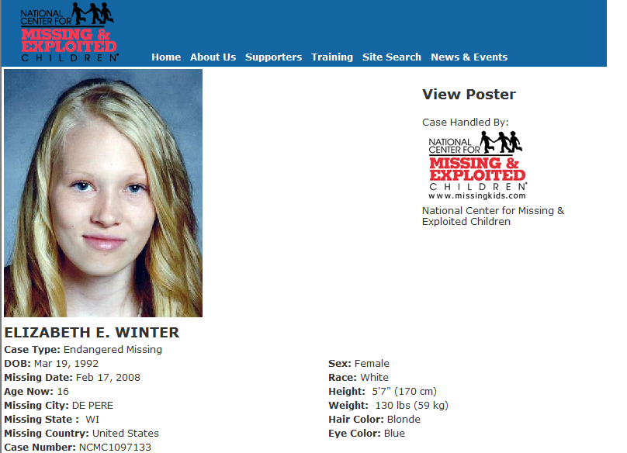
Runaways

Slide 36

Photos and Fingerprints of Runaways
Family Code 58.0022
May fingerprint or photograph a child if there is probable cause to believe the child is a runaway and the officer is unable to determine the identity of the child
Prints and photographs must be destroyed after runaway is resolved

Slide 37
City of Carrollton Ordinance
  It shall be unlawful for a minor child to intentionally or knowingly become a runaway in defiance of or for the purpose of not complying with a parental direction
  Runaway. A minor child who has absented himself voluntarily from his home or place of residence without the consent of his parent, as defined herein
  Minor child. Any person under the age of 17 years who resides with his or her parent, as defined herein, and has not otherwise been emancipated

Slide 38
Runaway State Law
Conduct indicating a need for supervision includes: The voluntary absence of a child from the child's home without the consent of the child's parent or guardian for a substantial length of time or without intent to return
Ubanski v. State: Absence for less than 24 hours still “substantial” under definition of runaway
Factors determining whether it is a “substantial length of time” include:
    Duration of the absence
    Time of day
    Intent to return
    The authorization, if any, for the child’s absence
    Age
    Maturity
    Experiences of the persons accompanying the child, if any, during his/her absence
For the purposes of this subsection a "child" does not include a person who is married, divorced, or widowed

Slide 39
Missing Child State Law
Code of Criminal Procedure 63.001
Missing child means a child whose whereabouts are unknown
to the child's legal custodian, the circumstances of whose
absence indicate that:
    The child voluntarily left the care and control of his legal custodian without the custodian's consent and without intent to return

Slide 40
Law Enforcement Requirements
Code of Criminal Procedure 63.009
  Start an investigation with due diligence in order to determine the present location of the child or person
  If the child is in danger, immediately start an investigation in order to determine the present location of the child or person
  On determining the location of a child under this subsection, other than a child who is subject to the continuing jurisdiction of a district court (custody issue), an officer shall take possession of the child and shall deliver or arrange for the delivery of the child to a person entitled to possession of the child. If the person entitled to possession of the child is not immediately available, the law enforcement officer shall deliver the child to the Department of Protective and Regulatory Services.

Slide 41
Attorney General Opinion
No. JC-0229 (2000)
  A law enforcement officer has an affirmative duty to
  take possession of a missing child whom he or she
  has located and can use reasonable force to do so
  (The fact scenario this opinion was based on was a 17
  year old missing child)

Slide 42
Attorney General Opinion
No. GA-0125 (2003)
An unemancipated 17 year old who voluntarily leaves the care and control of his legal custodian without consent and without intent to return is not a missing child if the custodian knows where the child is located
If the custodian determines the location after filing a report and notifies the investigating agency, the agency has no duty to continue the investigation or take possession of the child and return him to the custodian

Slide 43
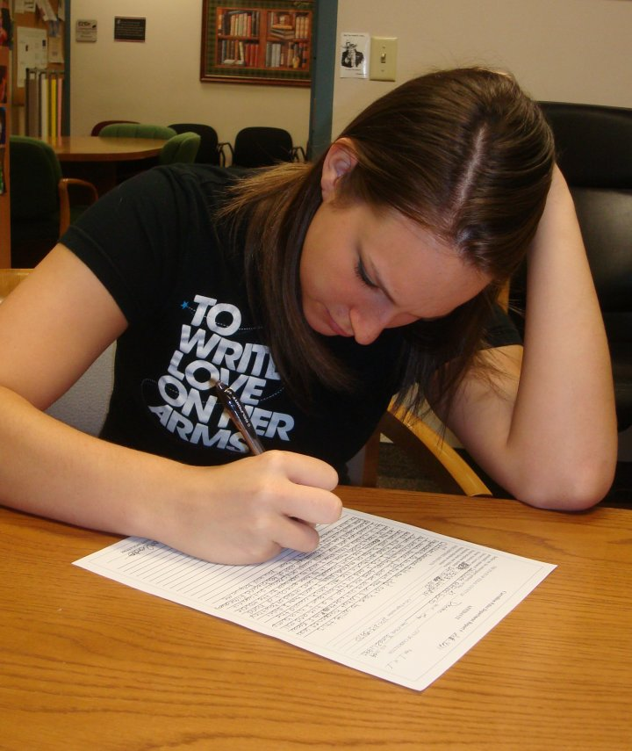
Juvenile Statements

Slide 44
Waiver of Rights
Family Code 51.09
Unless a contrary intent clearly appears elsewhere in this title, any right granted to a child by this title or by the constitution or laws of this state or the United States may be waived in proceedings under this title if:
  The waiver is made by the child and the attorney for the child
  The child and the attorney waiving the right are informed of and understand the right and the possible consequences of waiving it
  The waiver is voluntary
  The waiver is made in writing or in court proceedings that are recorded

Slide 45
Admissibility of a Statement of a Child
Family Code 51.095
  Trumps 51.09 and allows child to waive the right without an attorney
  Deals only with custodial statements
  Court cases have shown that any interview of a person suspected in a crime will have coercive aspects to it, but will not necessarily be considered custodial
  Adult version is CCP 38.22
  Applies to anyone 17 or younger who committed an offense while 10-16 years of age
  Does not apply to those 18 or older

Slide 46
  If in doubt, use the juvenile rules. They comply with the adult rules
  Written custodial statements of juveniles are not called confessions
  Warning and statement must be done in a Juvenile Processing Office (JPO)
  Childs v State: False claim by 17 year old that is 17 waives Family Code interrogation protections
  A Magistrate Warning is not needed for a written statement from a juvenile regarding a Class C violation handled only in Municipal/Justice Court. CCP 38.22 rules would apply

Slide 47
Is He In “Custody?”
Custody is decided based on a “Reasonable Juvenile” taking into account age and experience
Use of physical force to restrain or restrict movement
A display of authority from which a reasonable person would not feel free to leave
Definition of Custody in F.C. 51.09
  Custody includes:
    Being in the custody of a peace officer
    Being in a detention facility or other confinement
    Being in the custody of DPRS while being suspected of committing a crime

Slide 48
Allows 4 Types of Custodial Statements
A written or recorded statement made in a JPO after the child receives a Magistrate Warning in a JPO
An oral statement of facts or circumstances that are found to be true and tend to establish the child's guilt, such as the finding of secreted or stolen property, or the instrument with which the child states the offense was committed
A Res Gestae statement
A voluntary statement that has a bearing on the credibility of the child as a witness

Slide 49
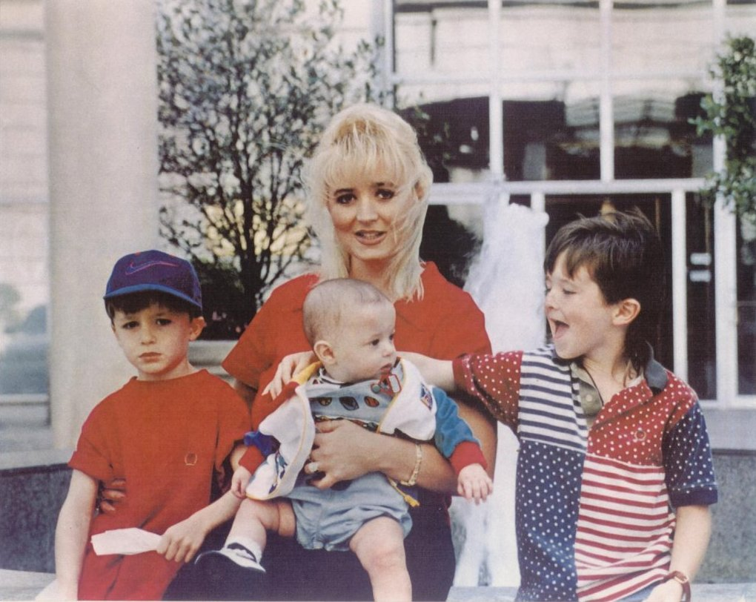
I Want My Mommy!
Request for a parent’s presence must be honored
Does not mean interview must stop if no parent is available
Not the same as the request for an attorney
An officer does not have to inform the child of their right to have a parent present
If a child requests a probation
officer be present, it is not an
invocation of rights. The request
does not have to be honored.

Slide 50
Magistrate Warning Procedures
  Notify parents of the arrest first. You DO NOT have to notify them of your intention to get a statement. A parent CANNOT invoke a child’s rights.
  Failure to notify parents first may result in the confession being suppressed
  Best practice is to not conduct ANY custodial interview until the Magistrate Warning has been read and rights waived
  If question the child prior to the Magistrate Warning, read the Miranda Warning
  If you read Miranda and obtain an inadmissible oral confession, you must notify the magistrate of the oral statement and magistrate should notify the child the statement is inadmissible
  Request magistrate
  Leave the room (except at request of magistrate)
  Magistrate will read warnings and determine if child is giving a statement voluntarily

Slide 51

  Magistrate will leave the room
  Officer goes back in and obtains the statement
  Officer leaves the room
  Magistrate goes into room with 2 civilian witnesses to certify the statement
  Audio and video recorded statements are allowed

Slide 52
Non-Custodial Interrogation
  Leading factors in showing not in custody:
    Repeated statements to the child that he is not in custody
    Allowing the child to leave
  Have child write on statement or state on audio/video recording that the child is not in custody and free to leave
  No Miranda
  Adult rules apply (CCP 38.22)
  School personnel doing questioning is never in custody
  Becomes custodial if acting as agent of police

Slide 53
Will the confession be suppressed?
Any statement must first be deemed voluntary
Voluntariness is decided based on a Totality of the Circumstances
Can an 11 year old girl who was held by police for 9 hours and who did not consult with a parent or attorney give a voluntary statement?

Slide 54
Factors a Magistrate considers to decide the voluntariness of a statement
  Age
  Searched
  Parents present
  Miranda Warnings
  Officer’s intentions
  Last meal
  Interview location
  Child’s mental state
  Breaks taken
  Questions
  Mental capacity
  Intelligence
  Handcuffed
  Freedom to leave
  Magistrated
  Prior legal conduct
  Grade level
  Number of officers
  Promises to child
  Writer of statement
  Prior oral statements
  Request for attorney
  Length of interview
  Maturity of child

Slide 55
Polygraph Examination
Family Code 51.151
Prohibited for juvenile suspects unless consent obtained from child’s attorney or juvenile court
Allowed for juveniles transferred to adult court
Does not prohibit the use of polygraph for child victims

Slide 56

Suggested Reading
On Combat
On Killing
Terror at Beslan
Stop Teaching Our Kids to Kill
Training at the Speed of Life
Deadly Force Encounters
Voices from the Kill Zone
Hollywood vs. America
The Mental Edge
We sleep safely in our beds because rough men stand ready in the night to visit violence on those that would do us harm.
George Orwell

Slide 57
COLE LANGSTON
CARROLLTON POLICE
COLE.LANGSTON@CITYOFCARROLLTON.COM
972-968-5438

Slide 58
TEXAS FAMILY CODE
INSTRUCTOR: OFFICER COLE LANGSTON
CARROLLTON POLICE DEPARTMENT

